Slide 1
A Scheme for Factoid Question Answering Over Knowledge Base
Happy BUZAABA, Toshiyuki AMAGASA
2019 - 02 - 25
KDE-LAB
UNIVERSITY OF TSUKUBA

Slide 2
Outline
Introduction
Motivation
Related work
Objective
Approach
Results
Conclusion & Future work
A Scheme For Factoid Question Answering over Knowledge Base
February 25, 2019

Slide 3
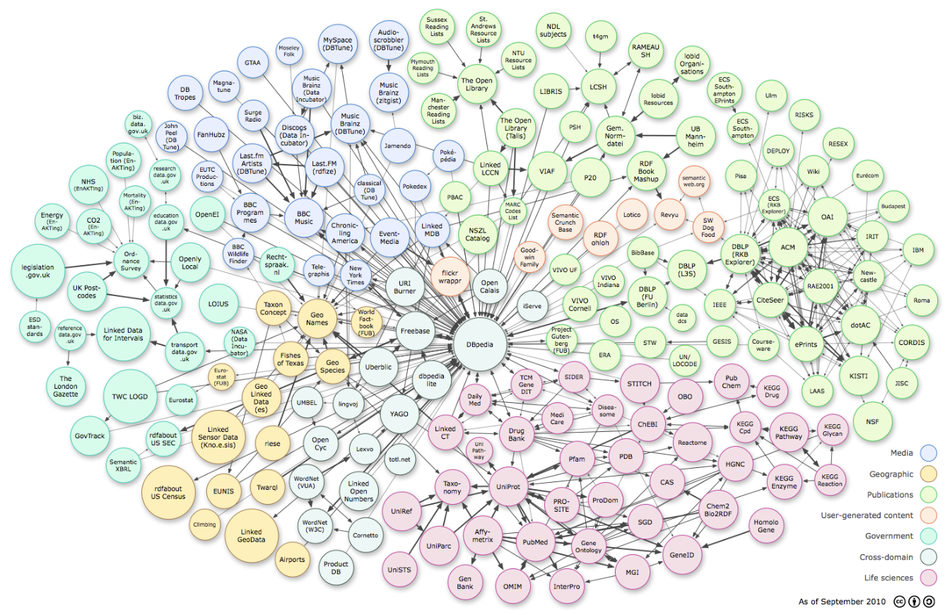
Knowledge Bases
A Scheme For Factoid Question Answering over Knowledge Base
February 25, 2019
Notes:
Lets start from the picture
This picture contains most of the Knowledge bases that have been widely used in both academic community and industry products
Colors represent the Domains
Surface area represent the number of facts in the Knowledge base
So we have many domains and some of them are very big

Slide 4
RDF_graph
(Subject, Relation, Object)
Ex Machina
The Tesseract
author
director
directed_by
written_by
spouse_s
Alex Garland
film
Dredd
Paloma Baeza
Child
has_spouse
Parent
Parent
Type_of_union
Nocholas Garland
Marriage
Eva Garland
Grand_Child
SPARQL query
Out put
PREFIX: <http://bedrock/>
SELECT ?subject ?predicate ?object
WHERE {?subject ?predicate ?object}
Subject Predicate Object
Alex Garland director Ex Machina
Ex Machina directed_by Alex Garland
The Tesseract author Alex Garland
Paloma Baeza has_spouse Alex Garland
A Scheme For Factoid Question Answering over Knowledge Base
February 25, 2019
Notes:
Data in these KB’s is stored in a structured format, for example for RDF data, it is structured in Subject, Predicate and Object format.
So for one to access this data they need to write a SPARQL query in order to to access the information they want.
But it is hard for non technical people who have not taken time to learn the query languages yet they want to access the information.

Slide 5
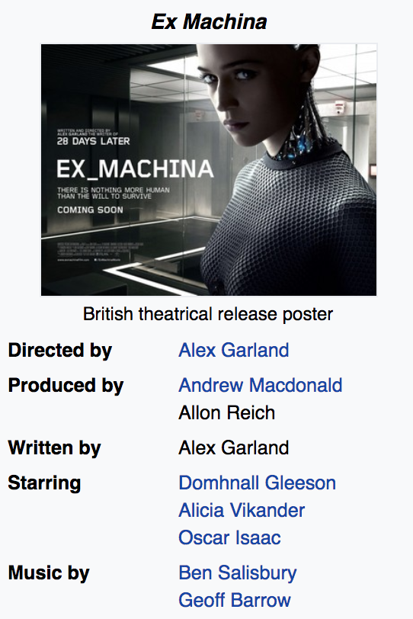

Knowledge base question answering
What else did the director of the movie Ex Machina direct?
Semantic Parsing
select ?y
fb:m.0fkf28
fb:object.type
fb:film.film
fb:m.0fkf28
fb:film.film.directed_by
?y
?x
fb:film.director.film
?y
?y
fb:object.type
fb:film.film
Annihilation 28 Days Later Sunshine
Never let Me Go Dredd
A Scheme For Factoid Question Answering over Knowledge Base
February 25, 2019
Notes:
So what KB question answering does is to allow user to pose questions in natural language and access answers from the Knowledge base.
For example given some information about Ex Machina, one may ask a question like what else did the director of the movie Ex Machina direct.
So the KB-QA system will try to first understand this question either by semantic parsing methods and convert this question into a structured query which is then executed on the KB to get the answers.
And the advantage of using KB for question answering is that you can get more precise and accurate answers.

Slide 6
Task definition
Question:
Where was Barack Obama born?
Formal definition:
1 – Subject: Barack Obama
1 – Relation: place_of_birth
KB_execution:
USA
The audacity of hope
8/04/1961
bornOn
President _of
Leader
authored_by
home_to
spouse_s
Barack Obama
Hawaii
Place_of_birth
Michelle Obama
has_spouse
origin
Parent
has_spouse
Kenya
Sasha Obama
Candidate tripple:
(‘Barack Obama’; ‘place_of_birth’; ‘Hawaii’)
A Scheme For Factoid Question Answering over Knowledge Base
February 25, 2019
Notes:
So in our work we try to tackle the problem of question answering over KB, specifically simple factoid question answering.
And more formally a simple question is a question of one subject and one relation
Assumption:
Assuming we have a natural language question q as a set of words
And a structured knowledge base with a set of triples where by a triple has two nodes connected by an edge
The task is to come up with a candidate triple from the KB that provides an answer to the question.
We make two assumptions:
We assume that the source entity is mentioned in the question
Question can be answered by a single fact.

Slide 7
Motivation

Slide 8
Motivation
Simple questions are common in web search, voice assistants, chatbots etc.
Large Simple questions benchmark with 108, 442 questions.
Simple questions benchmark is far from being solved
(76.4% state-of-the-art)
A Scheme For Factoid Question Answering over Knowledge Base
February 25, 2019
Notes:
It is also interesting because simples questions are common in web search, voice assistants and chatbots
So in 2015 bodes introduced a simples questions benchmark with over 100,000 questions
And this problem is far from being solved with 76.4% as the state-of-the-art

Slide 9
Related work

Slide 10
Related work?
Memory networks (Bodes et al., 2015)
Character-level attention-based Encoder-Decoder (Golub & He, 2016)
Attentive max-pooling (Yin et al., 2016)
Hierarchical word/char-level Encoder ( Lukovinikov et al., 2017)
A Scheme For Factoid Question Answering over Knowledge Base
February 25, 2019
Notes:
So in 2015, bodes introduced a simple questions dataset and proposed a memory network to tackle this problem
And this dataset triggered a line of work :
Where by some people use hierarchical architecture to enhance the model
Others use attention mechanisms to boost the performance
And others use character level modeling to further improve the performance.
But these new features introduce extra complexity into the models and the question here is whether these complexities are necessary in this particular dataset.

Slide 11
Objective
Examine necessity of model complexity
Examine simple and strong baseline that achieve reasonable performance
A Scheme For Factoid Question Answering over Knowledge Base
February 25, 2019
Notes:
So with this question in mind we took a challenge to:

Slide 12
Approach

Slide 13




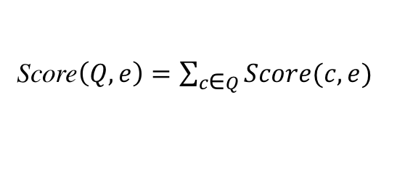
Approach: Details
Score$\left(Q, e\right)=\sum_{c\text{∈} Q}^{ }{Score(c, e)}$
$$\underset{e^{′}}{argmax} \max_{\left(e −r − e^{′}\right)∈\text{I}\text{reach} }Score(Q,e){ }$$
e| r | $e^{′}$
Score$\left(c, e\right)=\max{\text{n}\text{∈}N(c)} BM25(n, e)$
fact
Entity detection
Entity Linking
List(e, Score$\left(Q, e\right))$
Question
Entity: I Relation: r
Filtering
Relation classification
Structured
query
I_{inv}
I_{reach}
Inverted Index
Reachability Index
Knowledge Base
Build Index
Subj| rel | Obj
A Scheme For Factoid Question Answering over Knowledge Base
February 25, 2019
Notes:
Okay so putting all of this together:
We use the entity detection and relation classification
to convert the question into a structured query and use it to do question answering.
Our structured query is made up of the entity which is a substring of the question
obtained from sequence tagging and relation which is the output of the classifier.
So we build two indexes from the knowledge base to be able to do question answering;
Inverted index maps any n-gram to nodes in the KB with the associated scores
And so we get a list of candidates entity nodes
And use the reachability index to filter out nodes that can’t produce a reasonable answer
And finally we get answer as output.
Reachability Index maps nodes to other nodes (nodes in the freebase subset to all nodes reachable by a single relation)
The above is a quick mapping to be able to do QA in a very efficient way.

Slide 14
Approach: Entity detection - RNN
where
was
Barack
Obama
born
Embedding layer
Hidden layer
RNN (BiLSTM/BiGRU)
Fully Connected layers
0
0
I
I
0
I : Entity
0 : Non-entity
A Scheme For Factoid Question Answering over Knowledge Base
February 25, 2019
Notes:
For Entity detection:
We formulate this as a sequence tagging problem
And do prediction at every time step
The embedding layer maps each word index to a 300 embedding dimension and we use Glove pre-trained embeddings.
The hidden layer combines the current word embedding with the previous hidden state to compute the current state hidden representation.
The fully connected layers project the hidden layer representations to the output space of either entity or non entity.

Slide 15
Approach: Entity detection - CRF
Conditional Random Field: A conditional sequence model that represents the probability of a hidden state sequence given some observation
Stanford Named Entity Recognizer (NER):
Sequence labels: 4 classes
Person, Organization, Location, not-entity
We considered:
Entity : (Person, Organization, Location)
Two Classes : Entity
: Non-entity
A Scheme For Factoid Question Answering over Knowledge Base
February 25, 2019
Notes:
We also use CRF as our non-neural network method for Entity detection.
For CRF we use the Stanford NER which is a tool that can label a sequence of words into 4 classes of Person, Organization, Location and non-entity.
But in our case we consider the first three classes as entity.
So ultimately there were two classes.
This tool can extract features like current/ previous/next word, POS tags and character n-gram.

Slide 16
Approach: Relation Classification
where
was
Barack
Obama
born
Embedding layer
Hidden layer
RNN (BiLSTM/BiGRU)
Fully Connected layers
People/person/place_of_birth
NB: We also apply CNN from Kim et al 2014 for relation classification
A Scheme For Factoid Question Answering over Knowledge Base
February 25, 2019
Notes:
We also use BiLSTM and BiGRU
But different from entity detection because relation prediction is based on the whole sentence
So we only consider the final hidden state.
So there are 1,837 unique relation types in the dataset. And the objective is to do large scales classification with all possible labels and assign a relation type to the question.
We also use CNN from Kim et al 2014 for relation classification.
In this paper they use a simple CNN with little hyperparameters for sentence classification.

Slide 17
Approach: Entity linking – Creating the Inverted Index
e1: max{tfidf(“Barack Obama”, e1), tfid(“Obama”, e1), tfid(“Barack”, e1)}
= tfid(“Barack Obama”, e1)
= Score(n=2, tf=2/3, df=0.001)
e2: score(n=1, tf=1/2, df=0.01)
e3: score(n=1, tf=1, df=0.1)
Entity detection
Question
Entity: “Barack Obama” Relation: bornOn
Entity Linking
Relation classification
Structured
query
I_{inv}
Question
e₁
e₂
Michelle Obama Barack (Person)
Sasha
Obama (Person)
“How old is Barack Obama?”
Barack
e₃
Obama (president)
n-grams
Barack Obama
Obama
A Scheme For Factoid Question Answering over Knowledge Base
February 25, 2019
Notes:
Okay so here is one example:
We have a question How old is Barack Obama
The structured query then will hopefully have entity Barack Obama
And relation bornOn.
So then for entity linking we will use inverted Index as I mentioned
And the Inverted Index will have mappings from n-grams
Barack
Barack Obama
And Obama
To all the nodes in the KB
And the score of that association will be computed by tfidf
As shown in the equations in the top corner on the right hand side.
So in this case we will have a score for Barack Obama e1
e2 Sasha Obama
And e3 Obama the president

Slide 18
Approach: Entity linking – Creating the Reachability Index
e₄: 0.9
e₆: 0.3
fact
Relation = bornOn
Entity detection
Candidates = [<e₁,0.9>, <e₂,0.3>, <e₃,0.6>]
Question
Entity: “Barack Obama” Relation: bornOn
Entity Linking
Filtering
Relation classification
Structured
query
Question
I_{reach}
e₁
e₂
“How old is Barack Obama?”
presidentOf
Michelle Obama Barack (Person)
Sasha
Obama (Person)
e₅
bornOn
United_states
e₃
e₄
bornOn
Obama (president)
6/10/2001
8/4/1961
e₆
A Scheme For Factoid Question Answering over Knowledge Base
February 25, 2019
Notes:
The next step is to do filtering now that we have the
candidate nodes from which we believe we can get an answer from.
We want to find the actual answers.
So to do filtering we rely on the structured query again,
We look at the relation type there which is bornOn and we will filter out
all the nodes in our candidate set that do not have an edge born on going
to another node
So in this case e3 will be removed from the list of candidates and then
We will have e1 and e2 each of them being connected to e4 and e6 respectively through the edge bornOn.
So the answer will be e4 and e6 and the score of e4 will be the score of e1, in the previous stage
So e1 got a score of 0.9. so the answer score of e4 will be 0.9 and the score for e6 will be 0.3.
Which makes e4 the final answer.

Slide 19
Results

Slide 20
Experimental set up
Table 1: Simple question dataset Statistics
Table 2: Knowledge base Statistics
A Scheme For Factoid Question Answering over Knowledge Base
February 25, 2019

Slide 21
Results: Entity detection and linking
Table 3: Entity detection
Table 4: Entity linking
A Scheme For Factoid Question Answering over Knowledge Base
February 25, 2019
Notes:
For entity linking Recall on the top 1, 5, 20 and 50
And here we only compare the LSTM with CRF because the GRU performs worse than the LSTM.
And you can see that CRF produces results comparable to LSTM.

Slide 22
Results: Relation Prediction
Table 5: Relation Prediction
A Scheme For Factoid Question Answering over Knowledge Base
February 25, 2019

Slide 23
Results: End-to-end combination
A Scheme For Factoid Question Answering over Knowledge Base
February 25, 2019
Notes:
And for the end to end, we could see that the combination of BiLSTM for entity detection and BiGRU for relation prediction had the best result for all combinations.

Slide 24
Results: Comparison
A Scheme For Factoid Question Answering over Knowledge Base
February 25, 2019
Notes:
End-to-end are complex features which attempt to do entity and relation prediction in one neural model
The others are baselines
Custom neural architecture with non-standard. Architecture
Yin et al decomposes the problem into two components of entity linking and relation prediction but but introduces an attention max-pooling which introduces more complexity.
Dai et al 2016, first identifies subject entity mentions in the question and applys what they call Conditional focused neural network to perform question answering.

Slide 25
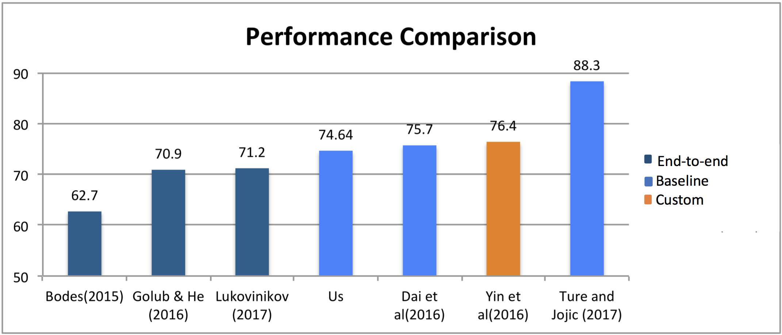
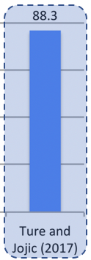
Results: Comparison
A Scheme For Factoid Question Answering over Knowledge Base
February 25, 2019
Notes:
End-to-end are complex features which attempt to do entity and relation prediction in one neural model
The others are baselines
Custom neural architecture with non-standard. Architecture
Yin et al decomposes the problem into two components of entity linking and relation prediction but but introduces an attention max-pooling which introduces more complexity.
Dai et al 2016, first identifies subject entity mentions in the question and applys what they call Conditional focused neural network to perform question answering.

Slide 26
Conclusion and Future work.

Slide 27
Conclusion
We explore simple yet effective approach for Simple question answering
There is still need to adequately examine simple baselines rigorously before rushing to sophisticated deep learning techniques at least for Simple QA.
Need to consider other non-neural network baselines in future
Consider more complex questions with joint knowledge sources.
A Scheme For Factoid Question Answering over Knowledge Base
February 25, 2019

Slide 28
Thank you Time for human Question Answering! 😉

